Slide 1
TOPIC A:
DATABASES
LESSON A-12
DATABASE SECURITY

Slide 2
AGENDA
Secure uses of databases
Privacy methods
Database Interrogation
NOTE!
Have a way to take notes available for this lesson

Slide 3

THE WARM UP QUESTION
A gym database needs to track members and the fitness classes they attend.
What is the relationship between members and classes in this database?
How should this information be stored?

Slide 4
THE WARM UP ANSWER
There is a many to many relationship between members and classes
Because of this, we need some sort of supporting table, perhaps called enrollment
Each class must have a member, but not each member must go to a class

Slide 5
SECURE USES OF DATABASES
AREA | EXAMPLE USE | IMPACT
Stock Control | Track inventory levels and reorder points | Prevent overstocking or shortages
Police Records | Criminal databases, fingerprints, surveillance data | Help identify suspects & track crimes
Health Records | Patient history, prescriptions, test results | Enables faster and safer medical care
Employee Data | Payroll, attendance, performance | Supports HR and compliance systems
What consequences might there be if any of these databases are breached?

Slide 6
SOCIAL/ETHICAL ISSUES
Privacy impacts – who has access to personal data?
Security impacts – how can we protect data from unauthorized access/hacking?
Integrity – how can we be sure that data is accurate, complete, and up to date?

Slide 7
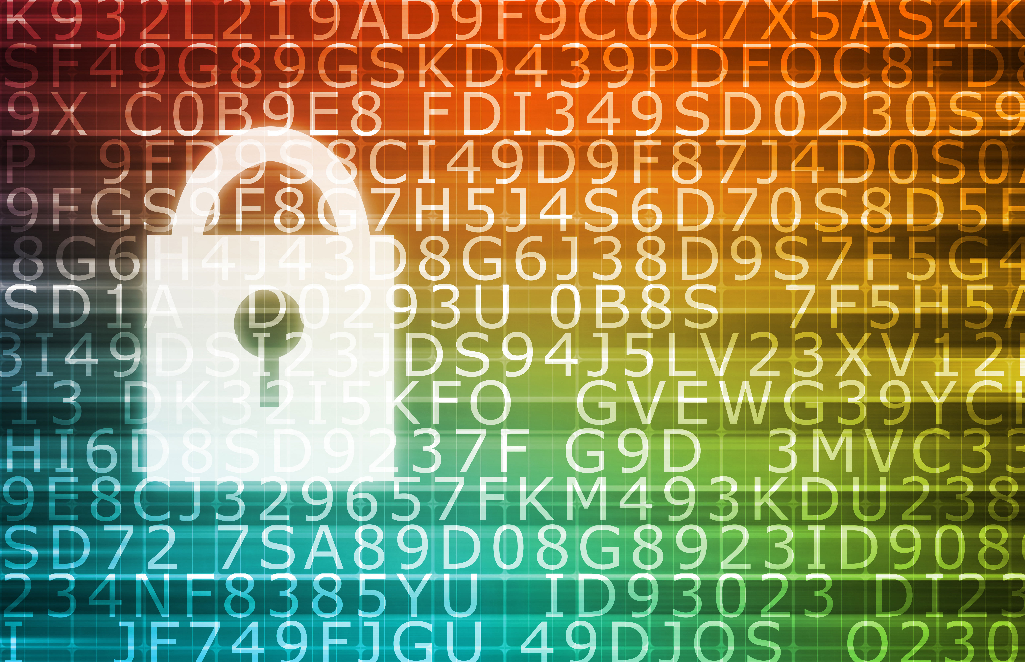
ENSURING PRIVACY
Encryption – protects data in storage during transfer
Without the key, data is very difficult to decrypt
Access Control – people can access data based on certain roles in the organization

Slide 8
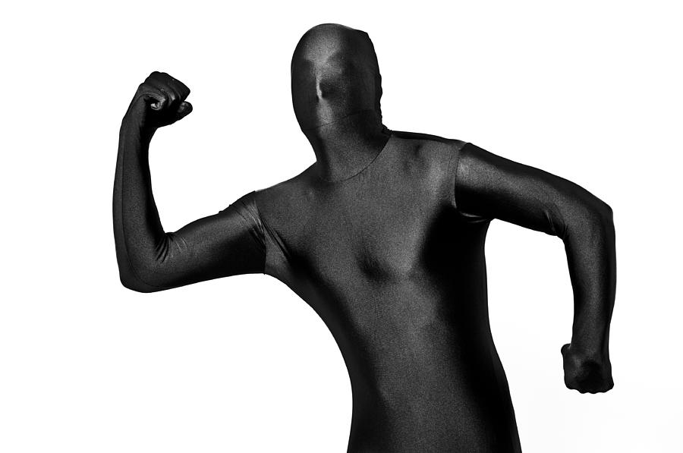
ENSURING PRIVACY
Anonymization – if data cannot be encrypted, you can remove personal identifying information
What information may constitute being personally identifiable?

Slide 9
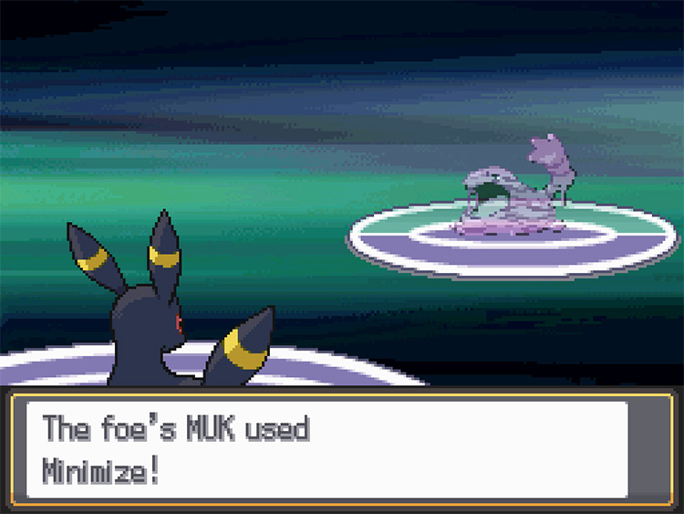
ENSURING PRIVACY
Data Minimization – collect ONLY what is necessary
This of course runs counter to the MO of companies who make money selling data
Regular Audits – detect unauthorized use or access of data

Slide 10

RESPONSIBILITY OF DATA HOLDERS
Data holders should be principled at least
Not sell personal data without consent
Should store data securely and accurately
Delete data when no longer needed
Inform users what data is collected and how it’s used.
Do these things always happen?

Slide 11
FORCING RESPONSIBILITY – THE HARD WAY
Because we cannot effectively trust these organizations to do this, we have legislation that helps to enforce it
The Privacy Act of 1974 relates only to government data collection
Health Insurance Portability and Accountability Act (HIPPA) protects health-based records
Gramm-Leach-Biley Act (GLBA) protects data for financial institutions
Children’s Online Privacy Protection Act (COPPA) protects children’s online information & gives parents rights to data

Slide 12
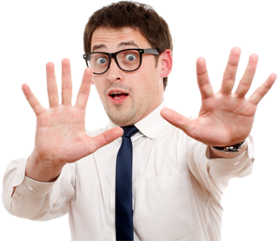
FORCING RESPONSIBILITY – THE HARD WAY
Different states and governments may also have more comprehensive data protection
California, Virginia
Yes, this means that your data otherwise isn’t really protected in the US
haveibeenpwned.com

Slide 13
FORCING RESPONSIBILITY – THE HARD WAY
These laws can enforce that data is:
Lawfully processed
Used for specific & legitimate purposes
Relevant & not excessive
Accurate & up to date
Kept no longer than necessary
Securely stored
Not transferred without adequate protection
A national bill failed to pass in 2022

Slide 14
LARGER DATABASES
What positives may come from having a very large database that the government uses to keep track of things
What downsides may come from this database?

Slide 15
DATABASE ACCESS (NOT THAT KIND)
In databases, there are plenty of acceptable ways to access and use data
Police investigating a crime
Government agencies monitoring public safety/taxes
Health department during epidemics
Even in justified situations, you can have risks
Potential abuse of power
Privacy violations
“Usage creep” – data used beyond original purpose

Slide 16
DATABASES
Despite how complex and negative they may seem, databases still form the backbone of information systems
They are used in decision making processes for small and large businesses alike
They can also be useful for automation and delivering services
But poor data management can lead to legal, financial, and ethical problems that we still don’t have comprehensive ways of handling yet as a society

Slide 17
DISCUSSION
Try to list EVERY organization that has data about you
What data do you think they have about you
Try to group the organizations together with broad themes, and decide what is and isn’t appropriate for each group to have

Slide 18
WS A-3 BAYBEE
WS A-3 is up on Github for you to… enjoy?
This time around instead of just filling in the worksheet, you’ll be making a powerpoint presentation.
You won’t have to present it, but you are free to if you would like for +10% credit on any non-test grade

Slide 19

VOCAB TO REMEMBER
Database Administrator
Backup
Restore
Rollback
Rollforwards
SQL Query
QBE Query
NL Query

